Slide 1
Database Systems
Lecture 3
THE RELATIONAL DATA MODEL AND RELATIONAL DATABASE CONSTRAINTS
Chapter 5
Alina Arshad
alina.arshad@nu.edu.pk

Slide 2
Insert Operations on Relations
In case of integrity violation, several actions can be taken:
Cancel the operation that causes the violation (RESTRICT or REJECT option)
Perform the operation but inform the user of the violation
Trigger additional updates so the violation is corrected (CASCADE option, SET NULL option)
Execute a user-specified error-correction routine

Slide 3
Violation of Constraints: Delete Operation
Delete operation can violate only referential integrity.
This occurs if the tuple being deleted is referenced by foreign keys from other tuples in the database.

Slide 4
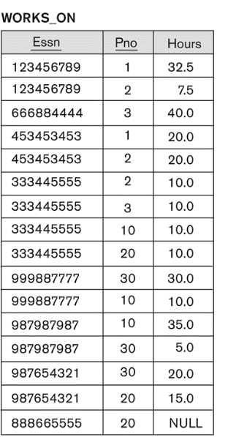
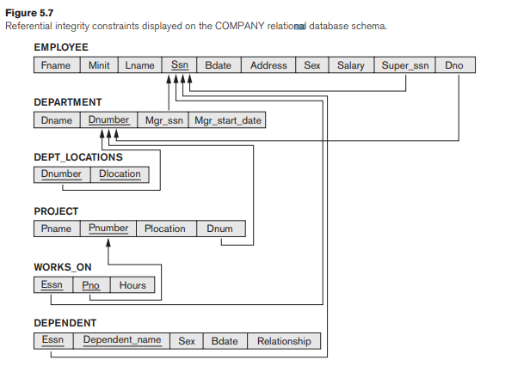

Violation of Constraints: Delete Operation

Slide 5

Violation of Constraints: Delete Operation

Slide 6
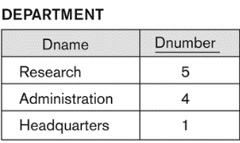
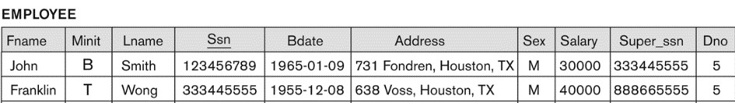
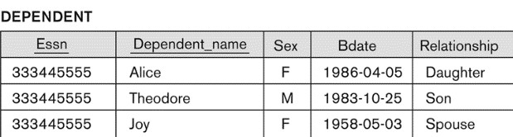

Violation of Constraints: Delete Operation

Slide 7
Violation of Constraints: Delete Operation
Options to overcome violation if a deletion operation causes a violation.
Restrict: is to reject the deletion.
Cascade: to cascade (or propagate) the deletion by deleting tuples that reference the tuple that is being deleted.
Set null or set default: is to modify the referencing attribute values that cause the violation
each such value is either set to NULL or changed to reference another default valid tuple.
Notice that if a referencing attribute that causes a violation is part of the primary key, it cannot be set to NULL; otherwise, it would violate entity integrity.
Combinations of these three options are also possible.

Slide 8
Violation of Constraints: Update Operation
Updating an attribute that is neither part of a primary key nor part of a foreign key usually causes no problems.

Slide 9

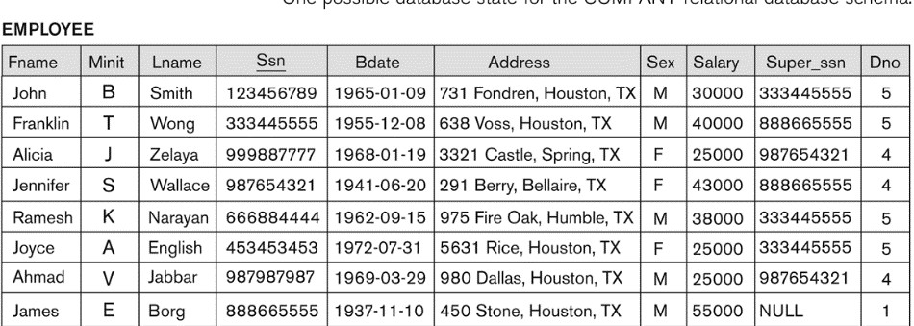
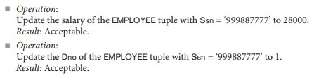
Violation of Constraints: Update Operation

Slide 10
Violation of Constraints:
Update Operation
Any of the other constraints may also be violated, depends on the attribute being updated:
Updating the primary key (PK):
Similar to a DELETE followed by an INSERT
Need to specify similar options to DELETE
Updating a foreign key (FK):
May violate referential integrity
Updating an ordinary attribute (neither PK nor FK):
Can only violate domain constraints

Slide 11
Transaction
A transaction is an executing program that includes some database operations, such as reading from the database, or applying insertions, deletions, or updates to the database.
After the transaction is completed the database must be in valid and consistent state that satisfies all the constraints.
For example, a bank withdrawal will typically read the user account record, check if there is a sufficient balance, and then update the record by the withdrawal amount.

Slide 12
Any question????

